Slide 1

108-NLP @ NCTU
e-Lab 1
Boaz

Slide 2
Good morning
Zoom!
Please change your name to StudentID + English name
3 hours is a very long time... we’ll take a break or two ☕
How to get my attention
Raise hand (please remember to un-raise)
Chat
Communications in English only. Thank you!

Slide 3
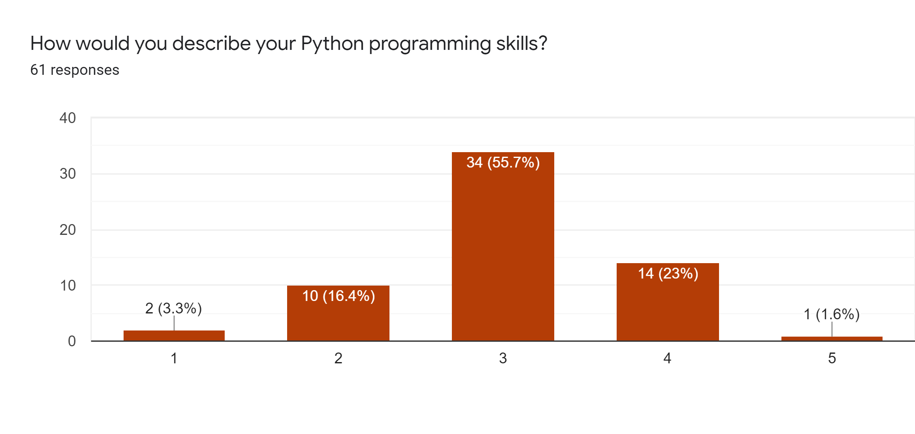
Survey - thank you for participating!
84% Master Students (also undergrads, PhD students)
98% have Python experience
36% most comfortable with Python

Slide 4
Outline
Google Colab
Tokenization
Bag-of-Words
Similarity
News article recommendation
Programming assignment

Slide 5


Google Colab
Run Python code in the cloud
Use Google hardware, including GPUs
Easy to share code
Free!
https://colab.research.google.com

Slide 6
Google Colab
Integration with Google Drive
Code cells, text cells, scratch cells
Moving cells
Importing libraries
System shortcuts
!ls !pip freeze
“Magics”

Slide 7
Tokenizer
Divide text into smaller units ("words")
>> s = “The quick brown fox jumps over the lazy dog” /* pangram */ >> tokenize(s)
[”The”, ”quick”, ”brown”, ”fox”, ”jumps”, ”over”, ”the”, ”lazy”, ”dog”]

Slide 8
Building our own tokenizer
Demo

Slide 9
Sentence Tokenizer
Split a document into a list of sentences
Is using “.” to split sentences good enough?
So we add ! and ?
Enough...
What about ?!
Also, “I love my M.Sc. studies in NCTU!”

Slide 10
Bag-of-Words
There is someone at the door
Put the book on the table
...
Vocabulary → | someone | book | door | the | is | put | table | film | there
Index → | 0 | 1 | 2 | 3 | 4 | 5 | 6 | 7 | 8
Document ↓
There is someone at the door | 1 | 0 | 1 | 1 | 1 | 0 | 0 | 0 | 1
Put the book on the table | 0 | 1 | 0 | 1 | 0 | 1 | 1 | 0 | 0

Slide 11
Bag-of-Words
Demo

Slide 12
Similarity
Demo

Slide 13
Issues with our program...
Stopwords
Punctuation
Uppercase/lowercase
BoW
Short documents

Slide 14

Lab 1 programming homework
Task: a better news recommendation engine!
Remove punctuation
Convert all tokens to lowercase
Remove stopwords (https://bit.ly/nlp-stopwords)
Replace BoW vectors with TF-IDF vectors (1000 top features by TF)
Instead of title, use content
Program from scratch: do not use any NLP or machine learning libraries
Warning: the system automatically detects plagiarism

Slide 15
Lab 1 programming homework
How we grade the assignment
Correctness: runs correctly when using “Runtime/Restart and run all…”
Clarity: logical, good documentation, meaningful variable names
Zero tolerance for cheating/plagiarizing
Submit by end-of-Thursday (23:59)

Slide 16
Submissions:
(Optional: start with a copy of the lab1-reuters.ipynb notebook)
Rename notebook to lab1-<studentID>.ipynb (for example, lab1-1234567.ipynb)
Submit Colab notebook link (https://colab.research.google.com/…)
Make sure the Colab notebook is shared for viewing!
Upload Python file lab1-<studentID>.py (for example, lab1-1234567.py) (In Colab, use “File/Download .py”)
Submit title of your own seed story + titles of its 5 most similar stories
Note: your seed story is corpus[StudentID % 1000]

Slide 17
Tips
To speed up running time during development use:
Smaller corpus
For example, instead of
corpus = df['title'].to_list()
Use
corpus = df['title'].to_list()[0:200]
Fewer features
For example, instead of
vocab = get_vocab(corpus).most_common(1000)
Use
vocab = get_vocab(corpus).most_common(100)
Don’t forget to revert before submitting

Slide 18
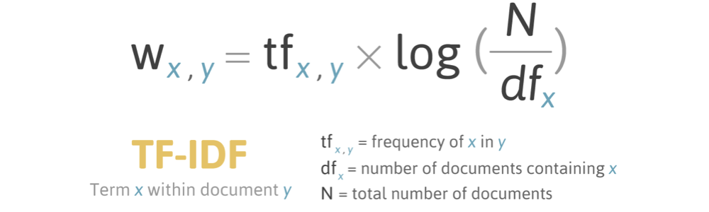
Reminder: TF-IDF

